Slide 1

Income from Capital Gains

Slide 2
Learning outcomes
The study of the chapter will provide information about :
The incomes chargeable under the head.
What is capital assets for capital gains purpose ?
How does transfer of capital assets occur.
The types of capital gains.
How to calculate capital gains.
Taxability of capital gains.

Slide 3
Chargeability:
Capital gains shall be chargeable to tax if following conditions are satisfied:
a) There should be a capital asset. In other words, the asset transferred should be a capital asset on the date of transfer;
b) It should be transferred by the taxpayer during the previous year;
c) There should be profits or gain as a result of transfer.

Slide 4
Meaning of Capital Asset [Sec 2(14)]
Capital Asset is defined to include:
a) Any kind of property held by an assessee, whether or not connected with business or profession of the assessee.
b) Any securities held by a FII which has invested in such securities in accordance with the regulations made under the SEBI Act, 1992.

Slide 5
What is not inluded in ‘capital asset’ u/s 2(14):
a) Stock-in-trade, consumable stores, raw materials held for the purpose of business or profession;
b) Personal effects (movable property) held for use of taxpayer or for any member of his family dependent upon him.
However, jewellery, costly stones, and ornaments made of silver, gold, platinum or any other precious metal, archaeological collections, drawings, paintings, sculptures or any work of art shall be considered as capital asset even if used for personal purposes;

Slide 6
What is not included in ‘capital asset’
c) 6-1/2% Gold Bond 1977 or 7% Gold bonds 1980 National Defence Bonds , 1980 issued by Central Govt.
d) Deposit certificates issued under the Gold Monetisation Scheme, 2015
d) Special Bearer Bonds 1991
e) Gold Deposit bonds issued under Gold Deposit Scheme 1999.
Deposits certificates issued under Gold Monetisation Scheme 2015 w.e.f. 2016-17.

Slide 7
What is not included in ‘capital asset’
Agricultural Land in India, not being a land situated:
a. Within jurisdiction of municipality, notified area committee, town area committee, cantonment board and which has a population not less than 10,000;
b. Within range of following distance measured aerially from the local limits of any municipality or cantonment board:
i. not being more than 2 KMs, if population of such area is more than 10,000 but not exceeding 1 lakh;
ii. not being more than 6 KMs , if population of such area is more than 1 lakh but not exceeding 10 lakhs; or
iii. not being more than 8 KMs , if population of such area is more than 10 lakhs.

Slide 8
municipality, notified area committee, town area committee, cantonment board
Population 10,000
Capital asset if within this area
municipality, notified area committee, town area committee, cantonment board
Population
10,001-1,00,000
Capital asset if within 2 km of limits

Slide 9
municipality, notified area committee, town area committee, cantonment board
Population
1,00,001-10,00,000
Capital asset if within 6 km of limits
municipality, notified area committee, town area committee, cantonment board
Population > 10,00,000
Capital asset if within 8 km of limits

Slide 10
Type of Capital Assets
A. Short Term Capital Asset Section 2(42A)
1. Capital asset held for not more than 36 months immediately prior to the date of transfer.
2. Following assets held for not more than 12 months shall be treated as short-term capital assets:
Equity or preference shares of companies listed in recognized stock exchange in India;
Securities listed in recognized stock exchange in India; Debentures, Bonds, Govt. Securities .
c) Units of UTI;
d) Units of equity oriented funds; or
e) Zero Coupon Bonds
3. Unlisted shares and immovable property (With effect from Assessment Year 2018-19, being land or building or both) held for not more than 24 months immediately prior to the date of transfer shall be treated as short-term capital asset.
Notes:
Any capital asset held by a person for a period of not more than 36 months immediately preceding the date of its transfer will be a short-term capital asset.
However, in respect of certain assets like shares (equity or preference) which are listed in a recognised stock exchange in India, units of equity oriented mutual funds, listed securities like debentures and Government securities, Units of UTI and Zero Coupon Bonds, the period of holding to be considered is 12 months instead of 36 months.
In case of unlisted shares in a company, the period of holding to be considered is 24 months instead of 36 months.
With effect from Assessment Year 2018-19, the period of holding of immovable property (being land or building or both), shall be considered to be 24 months instead of 36 months.
Any capital asset held by a person for a period of more than 36 months immediately preceding the date of its transfer will be treated as long-term capital asset.
However, in respect of certain assets like shares (equity or preference) which are listed in a recognised stock exchange in India, units of equity oriented mutual funds, listed securities like debentures and Government securities, Units of UTI and Zero Coupon Bonds, the period of holding to be considered is 12 months instead of 36 months.
In case of unlisted shares in a company, the period of holding to be considered is 24 months instead of 36 months.
With effect from Assessment Year 2018-19, the period of holding of immovable property (being land or building or both), shall be considered to be 24 months instead of 36 months.
https://www.incometaxindia.gov.in/_layouts/15/dit/mobile/faqs/faq-questions.aspx?key=FAQs+on+Capital+Gains&k=

Slide 11
Identify Short term and long term assets
Mr X Purchased listed shares in a company on march 16 2017 and transferred it on June 12-2018.
Mr y purchases units of and equity oriented mutual fund on July 7th 2016 and transfers these units on July 10 , 2018
Mr Z purchased gold on September, 12, 2015 and gifts the same to his friend Mr. P on December, 30, 2016. Mr P transfers the gold on October 20, 2018.
Mr. Q acquires a house property on March 16, 2017 and transfers it on June 12, 2018

Slide 12
Is the benefit of indexation available while computing capital gain arising on transfer of short-term capital asset?
​​​​Indexation is a process by which the cost of acquisition/improvement of a capital asset is adjusted against inflationary rise in the value of asset. The benefit of indexation is available only in case of long-term capital assets and is not available in case of short-term capital assets.​​
https://www.incometaxindia.gov.in/_layouts/15/dit/mobile/faqs/faq-questions.aspx?key=FAQs+on+Capital+Gains&k=

Slide 13
Type of Capital Assets
B. Long Term Capital Asset 2 (29A)
Capital Asset that held for more than 36 months or 24 months or 12 months, as the case may be, immediately preceding the date of transfer is treated as long-term capital asset
Notes:
Any capital asset held by a person for a period of more than 36 months immediately preceding the date of its transfer will be treated as long-term capital asset.
However, in respect of certain assets like shares (equity or preference) which are listed in a recognised stock exchange in India, units of equity oriented mutual funds, listed securities like debentures and Government securities, Units of UTI and Zero Coupon Bonds, the period of holding to be considered is 12 months instead of 36 months.
In case of unlisted shares in a company, the period of holding to be considered is 24 months instead of 36 months.
With effect from Assessment Year 2018-19, the period of holding of immovable property (being land or building or both), shall be considered to be 24 months instead of 36 months.
https://www.incometaxindia.gov.in/_layouts/15/dit/mobile/faqs/faq-questions.aspx?key=FAQs+on+Capital+Gains&k=

Slide 14
LTCG
Gain arising on transfer of long-term capital asset is termed as long-term capital gain and gain arising on transfer of short-term capital asset is termed as short-term capital gain. However, there are a few exceptions to this rule, like gain on depreciable asset is always taxed as short-term capital gain.​​​

Slide 15
Meaning of Transfer [Section 2(47)]
“Transfer”, in relation to a capital asset, includes:
(i) Sale, exchange or relinquishment of the asset;
(ii) Extinguishment of any rights in relation to a capital asset;
(iii) Compulsory acquisition of an asset;
(iv) Conversion of capital asset into stock-in-trade;
(v) Maturity or redemption of a zero coupon bond;
(vi) Allowing possession of immovable properties to the buyer in part performance of the contract;
(vii) Any transaction which has the effect of transferring an (or enabling the enjoyment of) immovable property; or

Slide 16
Identify capital asset
A car owned by an assessee and used by him and his family.
Movable personal effect
An air conditioning plant owned by a company and installed at the residence of its Managing Director.
Movable asset not personal effect for company.
Silverwares belonging to HUF which are placed before family deity at the time of pooja or worship on special occasions.
Capital asset not a personal effect.

Slide 17
Identify long term or short term capital gains
A Piece of land purchases on 26-July-2016 , sold on August 2018.
A gold Jewellary purchases on 30-Dec-2015 , sold on 20-Dec-2018
Purchased unlisted preference shares of a company on First May , 2016 , sold on 28-April-2018.

Slide 18
How to Calculate Short-Term Capital Gains?
Full value of consideration xxx
Deduct the following:
  Expenses on transfer xxx
  Net Consideration xxx
  Less: Cost of acquisition xxx
  Cost of improvement xxx xxx
This amount is a short-term capital gain xxx

Slide 19
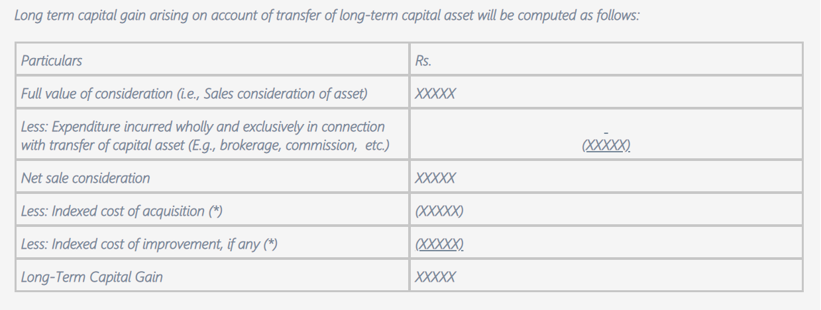

Slide 20
How to Calculate Long-Term Capital Gains?
Full value of consideration xxx
Deduct the following:
  Expenses on transfer xxx
  Net Consideration xxx
  Less: Indexed Cost of acquisition xxx
  Indexed Cost of improvement xxx xxx
This amount is a long-term capital gain xxx
From this resulting number, deduct exemptions provided under sections 54, 54F

Slide 21
Cost of Acquisition
Capital assets purchased or constructed- Cost of acquisition (including expenses) and cost construction.
Assets received without consideration – Cost of acquisition to previous owner
Assets acquired before First April 2001- Fair Market Value on First April 2001.

Slide 22
Cost inflation Index
Prices of goods increase over time resulting in a fall in the purchasing power (quantity of goods that one unit of money can buy) of money.
If 2 units of goods could be bought for Rs.100 today, tomorrow only 1 unit might be available for Rs. 100 due to increasing inflation.
Cost inflation index calculates the estimated rise in the cost of goods and assets year-by-year as a result of inflation. It is fixed by the central government in its official gazette to measure inflation. Section 48 of the Indian Income Tax Act, 1961, defines the index as notified by the government every year.

Slide 23
Cost inflation Index
Financial year Cost Inflation Index
2001-02 100
2002-03 105
2003-04 109
2004-05 113
2005-06 117
2006-07 122
2007-08 129
2008-09 137
2009-10 148
2010-11 167
2011-12 184
2012-13 200
2013-14 220
2014-15 240
2015-16 254
2016-17 264
2017-18 272
2018-19 280
2019-20 289

Slide 24
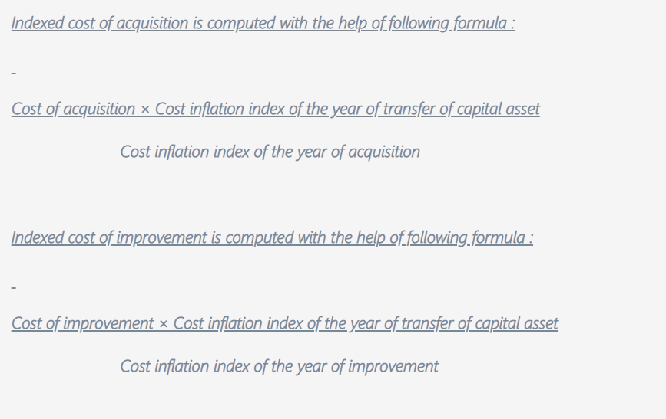


Slide 25
Cost of acquisition in 2002-03 Rs. 1,20,000 . Find out the indexed cost if sold in 2018-19 5,00,000 C.I.I. for 2002-03 is 105 and for 2017-18 is 280.

Slide 26
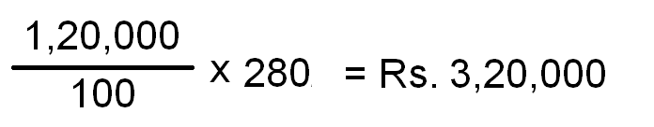

Slide 27
Practical Examples
Case 1: Rahul purchased a flat in FY 2001-02 for Rs. 10,00,000. He sells the flat in FY 2018-19 for Rs. 35,00,000 What will be the indexed cost of acquisition? Also calculate capital gains.
In this case, CII for the year 2001-02 and 2017-18 is 100 and 280 respectively.

Slide 28
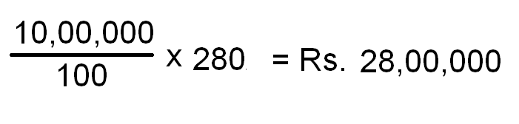
Solution
the Indexed Cost of Acquisition =

Slide 29
Calculation of LTCG
Gross consideration = 35,00,000
Less expenses = NIL
Net Consideration = 35,00,000
Less Indexed Cost
Of acquisition = 28,00,000
LTCG 7,00,000

Slide 30
Case 2: Shivani purchased a capital asset in FY 1995-1996 for Rs. 2,00,000. FMV of the capital asset on 1st April 2001 was Rs. 3,20,000. She sells the asset in FY 2016-17 for Rs. 11,00,000 .
What is the indexed cost of acquisition?
CII 2001-02 = 100
CII 2016-17 = 264

Slide 31
Here, the asset is purchased before the base year. Hence the cost of acquisition = Higher of actual cost or FMV on 1st April 2001.
i.e. Cost of Acquisition = Rs. 3,20,000.
CII for the year 2001-02 and 2016-17 is 100 and 264 respectively.
Indexed cost of acquisition = 3,20,000 x 264/100 = Rs. 8,44,800.

Slide 32
Calculation of LTCG
Gross consideration = 11,00,000
Less expenses = NIL
Net Consideration = 11,00,000
Less Indexed Cost
Of acquisition = 8,44,800
LTCG 2,55,200

Slide 33
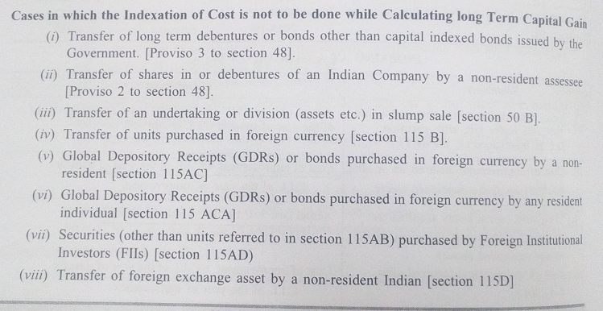
When Indexed cost of acquisition is not calculated

Slide 34
Transfer by way of gift
Sec. 49(1) of the Act provides that in the case of an assessee acquiring an asset under a gift, inheritance or will etc.,
the cost of acquisition of the asset shall be deemed to be the cost for which the previous owner of the property acquired it,
as increased by the cost of any improvement of the asset incurred or borne by the previous owner or the assessee as the case may be.

Slide 35
Treatment of advance money received and forfeited
Proviso to section 51
W.e.f A.Y. 2015-16 any sum received as an advance or otherwise in the course of negotiations for transfer of capital asset and forfeited due to non transfer of such capital asset shall be treated as income from other sources. Since it is a capital receipt it was earlier allowed as a deduction from the cost of acquisition under section 51.

Slide 36
Important note
Any advance money received and forfeited during 2013-14 or before, shall be reduced from cost of acquisition , WDV/FMV even if such capital asset is transferred during P.Y. 2014-15 or after wards. Any advance received and forfeited during the previous year 2014-15 or after wares will be taxable as “Income from other sources” in the year in which it is forfeited.

Slide 37
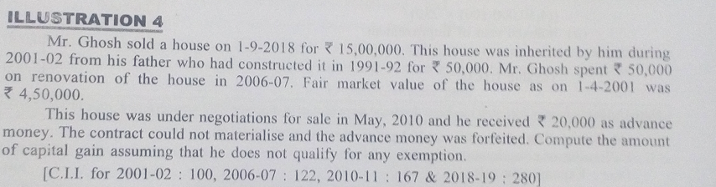

Slide 38
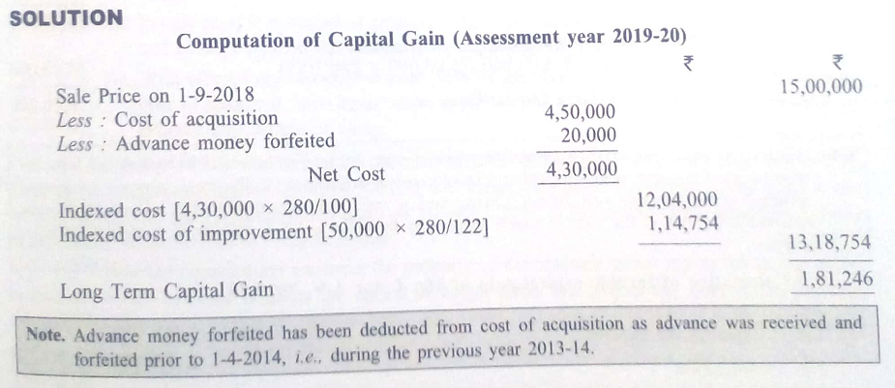

Slide 39
Exemption U/s 54
1. Capital Gain on transfer of long term residential house property (Sec. 54)
2. Capital Gain on transfer of self cultivated agricultural land in urban areas (Sec. 54 B)
3. Capital gain on compulsory acquisition of land and building (Sec 54D)
4. Capital Gain on transfer of long term capital Asset (Sec. 54EC)
5. Capital Gain on transfer of long term capital Asset(other than residential house property) and investment made in the purchase or construction of residential house property (Sec. 54F)

Slide 40
Exemption under Section 54
When an individual sells a residential property and buys another residential property, he will be eligible for exemption under Section 54. Conditions to avail the benefit of exemption under Section 54 includes:
The taxpayer (ie. seller) needs to be an individual or HUF. Thus, firms, LLP’s and companies cannot utilize the benefits of this section.
Asset needs to be classified as a long-term capital asset.
The asset sold is a Residential House. Income from such a house should be chargeable as Income from House Property

Slide 41
Exemption under Section 54 contd..
The seller should purchase a residential house either 1 year before the date of sale/transfer or 2 years after the date of sale/transfer. In case the seller is constructing a house, it will have to be constructed within 3 years from the date of sale/transfer.
In case of compulsory acquisition, the period of acquisition or construction will be determined from the date of receipt of compensation (whether original or additional compensation)
The new residential house should be in India.
If the new house is sold within 3 years from the date of purchase or construction, then the exemption claimed earlier under section 54 shall be indirectly taxable in the year of sale of the new house property.

Slide 42
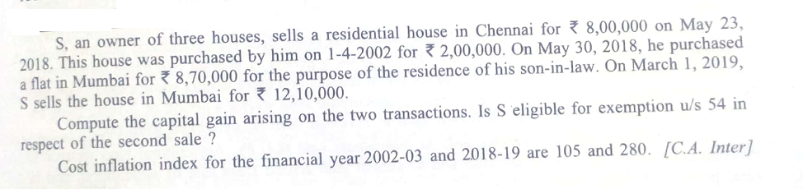

Slide 43
Sales price 8,00,000
Less indexed cost of acquisition 5,33,333
LTCG 2,66,667
Less exemption u/s 54 2,66,667
Taxable LTCG NIL

Slide 44
Sales of newly purchased house 12,10,000
Less cost price 8,70,000
STCG 3,40,000
LTCG exemption of Rs 2,66,667 availed on the purchase of this house will also be taxable because the house is sold within two years of purchase.

Slide 45
Exemption u/s 54F
The exemption available only to individual and HUF;
Capital gain has arisen on account of transfer of any long term capital assets other than residential house;
The assessee should not own more than one house property on the date of transfer of above mentioned assets.

Slide 46
Contd..Exemption u/s 54F
Net consideration arisen on account of transfer of long term capital assets has been invested as follows –
Net consideration has been re-invested in purchase of one residential house within a period of 1 year before the date of transfer or within a period of 2 years after the date of transfer; or
Net consideration has been re-invested in construction of one residential house in India within a period of 3 years from the date of transfer.

Slide 47
Amount of exemption
In case assesse invests the full amount of net consideration in purchase or construction of house property full amount of long term capital gains shall be exempted.
But if assessee invests a part of net consideration then a proportionate part of capital gain shall be exempted.

Slide 48
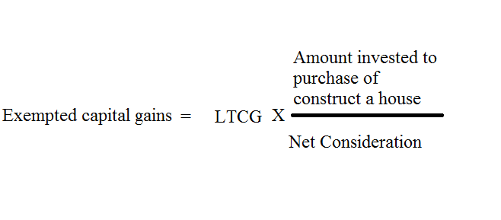
Formula

Slide 49
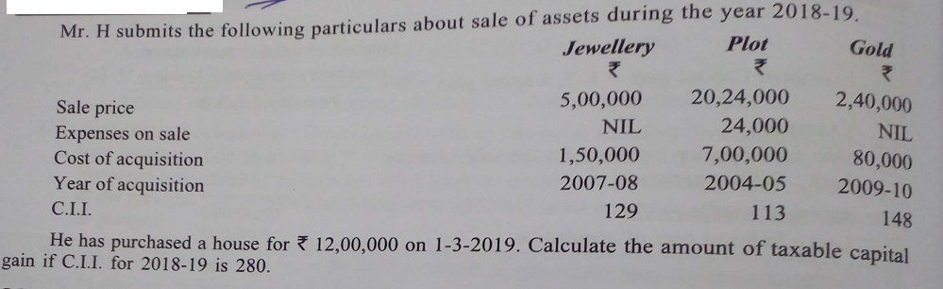

Slide 50
Calculation of taxable capital gains
Jewellery Plot Gold
Rs. Rs. Rs.
Sales price 5,00,000 20,24,000 2,40,000
Less : Expenses on sales NIL 24,000 NIL
Net Consideration 5,00,000 20,00,000 2,40,000
Less indexed cost 3,25,581 17,34,513 1,51,351
Long Term Capital Gain 1,74,419 2,65,487 88,649
Less exemption U/s 54 F 88,649
Second from jewellery 1,74,419
Then proportionately 61,062 Taxable LTCG NIL 2,04,425 NIL

Slide 51
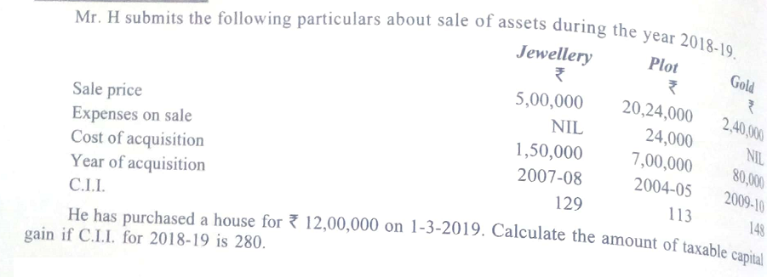

Slide 52
Calculation of taxable capital gains
RH Plot Gold
Rs. Rs. Rs.
Sales price 5,00,000 20,24,000 2,40,000
Less : Expenses on sales NIL 24,000 NIL
Net Consideration 5,00,000 20,00,000 2,40,000
Less indexed cost 3,25,581 17,34,513 1,51,351
Long Term Capital Gain 1,74,419 2,65,487 88,649
Deduction u/s 54 1,74,419
Less exemption U/s 54 F
Second from jewellery 1,74,419
Then proportionately 61,062 Taxable LTCG NIL 2,04,425 NIL

Slide 53
Indexed cost
Jewellery
1,50,000 X280 = 3,25,581
129
Plot
7,00,000 X280 = 17,34,513
113
Gold
80,000 X280 = 1,51,351
148

Slide 54
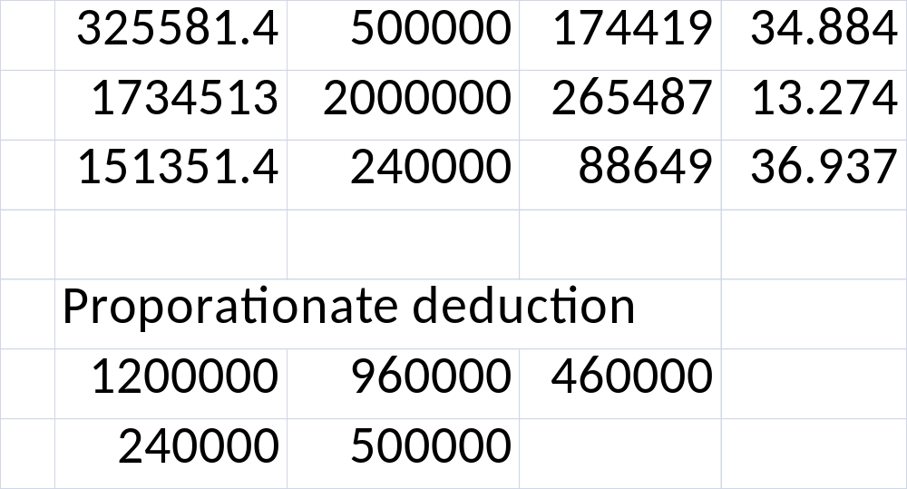
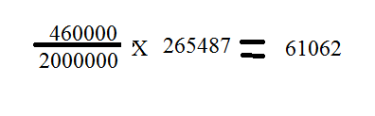

Slide 55
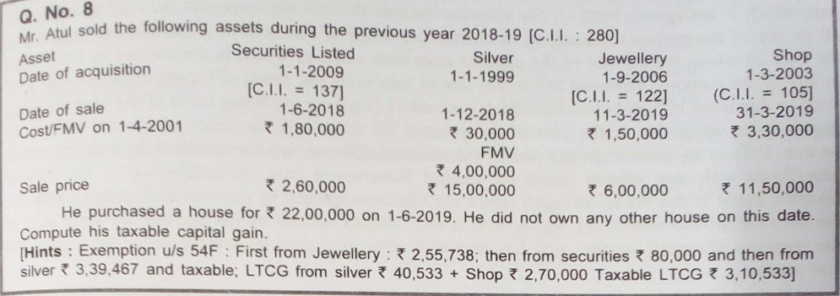

Slide 56
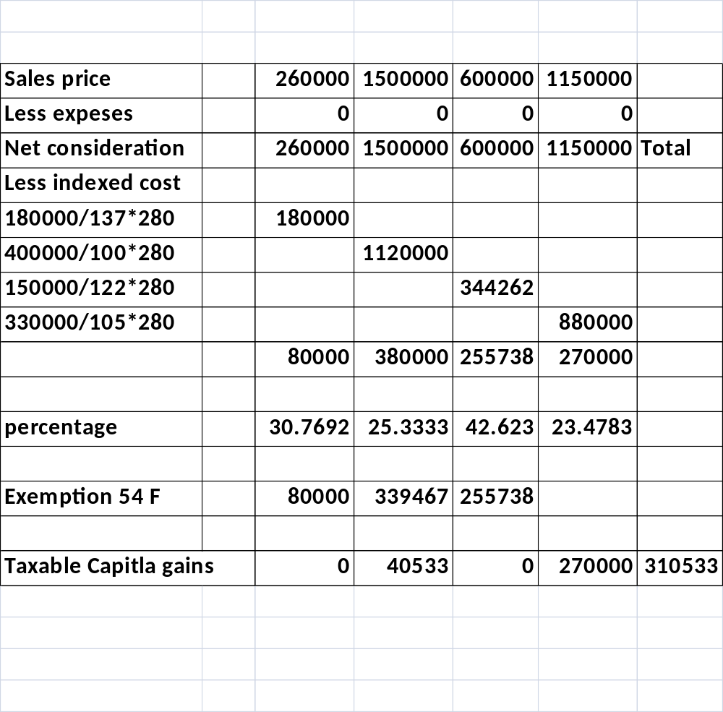

Slide 57
2200000 600000
1600000 260000
1340000
1340000/1500000*380000 339467

Slide 58
MCQs
Capital gains arise on
Business Capital ,(b) Transfer of capital Asset ,
(c) Stock of trade , (d) All of these
2. Capital gain on depreciable asset will always be:
(a) STCG , (b) LTCG , (c) Tax Free , (d) None of the above
3. Gift of an asset is treated as:
Sales , (b) Transfer , (c) Both of the above , (d) None of the above
4. Stock of trade is deemed to be a capital asset:
(a) True (b) False

